Slide 1
Meera Menon
Software Engineering Capstone Project

Slide 2

ServiceEase: Your Go-To Marketplace for In-Home Services

Slide 3
Agenda
Define: Business Context, Stakeholders, and Value
Design: Git/README, Documentation, Project Planning, and Testing
Delivery: Server Quality, User Interface, Functionalities, Database, and Live Demo
Questions

Slide 4
Business Context
ServiceEase is a marketplace for in-home services like cleaning, plumbing, salon services, etc., tailored for New Zealand.
New Zealand lacks a unified platform for booking in-home services like cleaning, plumbing, or salon services, creating an opportunity for ServiceEase to fill this gap.
It bridges the gap between service providers and customers seeking reliable services.

Slide 5




Competitors

Slide 6
How does Service Ease add value?
ServiceEase aims to offer an easy-to-use platform where customers can browse, compare, and book reliable service providers without the hassle of manual searches or unverified options.
The platform provides visibility and a digital marketplace for small and medium service providers, helping them reach more customers and grow their business.
By simplifying the booking process and building trust through verified providers, ServiceEase creates value for both customers (time-saving, reliability) and service providers (increased bookings, revenue growth).

Slide 7
Stakeholders
Primary Stakeholders:
Customers: Individuals seeking reliable in-home services, such as cleaning, plumbing, or salon services. They value convenience, transparency, and trustworthy providers.
Service Providers: Local businesses or professionals offering in-home services who rely on the platform for visibility and to connect with potential customers.
Secondary Stakeholders:
Platform Administrators: Responsible for maintaining and managing the platform, ensuring smooth operations, and addressing customer or provider issues.
Technology Partners: Providers of tools or integrations (e.g., payment gateways, hosting services) that enable the platform's functionality.

Slide 8
Project Planning
Research :
Conducted market analysis to identify gaps in the New Zealand in-home services market.
Studied user needs and pain points for both customers and service providers.
Evaluated existing platforms (e.g.,Loco Pro, Assign, Builders Crack) for insights and feature prioritization.
Design :
Created a Lucid Chart Lo-Fi prototype for the user interface, incorporating feedback from peers and mentors.
Designed the database schema to align with key functionalities like service categories, booking management, and user profiles.
Development :
Backend API development using Node.js, Express, and MongoDB.
Frontend implementation using React, focusing on responsive design and user experience.
Integrated authentication, CRUD operations, and essential features like service search and booking.

Slide 9
User Stories
Book a Service – High Priority
As a customer, I want to browse and book a service easily, so I can save time and effort in finding a reliable provider.
Service Provider Registration - High Priority
As a service provider, I want to register my business and add service details, so I can reach a wider audience and increase bookings.
Receive Booking Notifications – Medium Priority
As a customer, I want to receive notifications about my service booking status, so I can stay informed about updates and reminders.
Manage Bookings – High Priority
As a service provider, I want to view and manage my bookings, so I can plan my schedule efficiently and avoid conflicts.

Slide 10
User Stories
Provide Service Feedback – Medium priority
As a customer, I want to leave a review for completed services, so I can help others make informed decisions.
View Earnings Report – Medium priority
As a service provider, I want to view my earnings over time, so I can track my revenue and growth.
Explore Subscription Packages – Low Priority
As a customer, I want to explore subscription plans for frequent services, so I can save money and have consistent support.

Slide 11
Feedback
Overall Experience
Ease of Use
Features and Functionality
Service Quality
Suggestions for Improvement

Slide 12
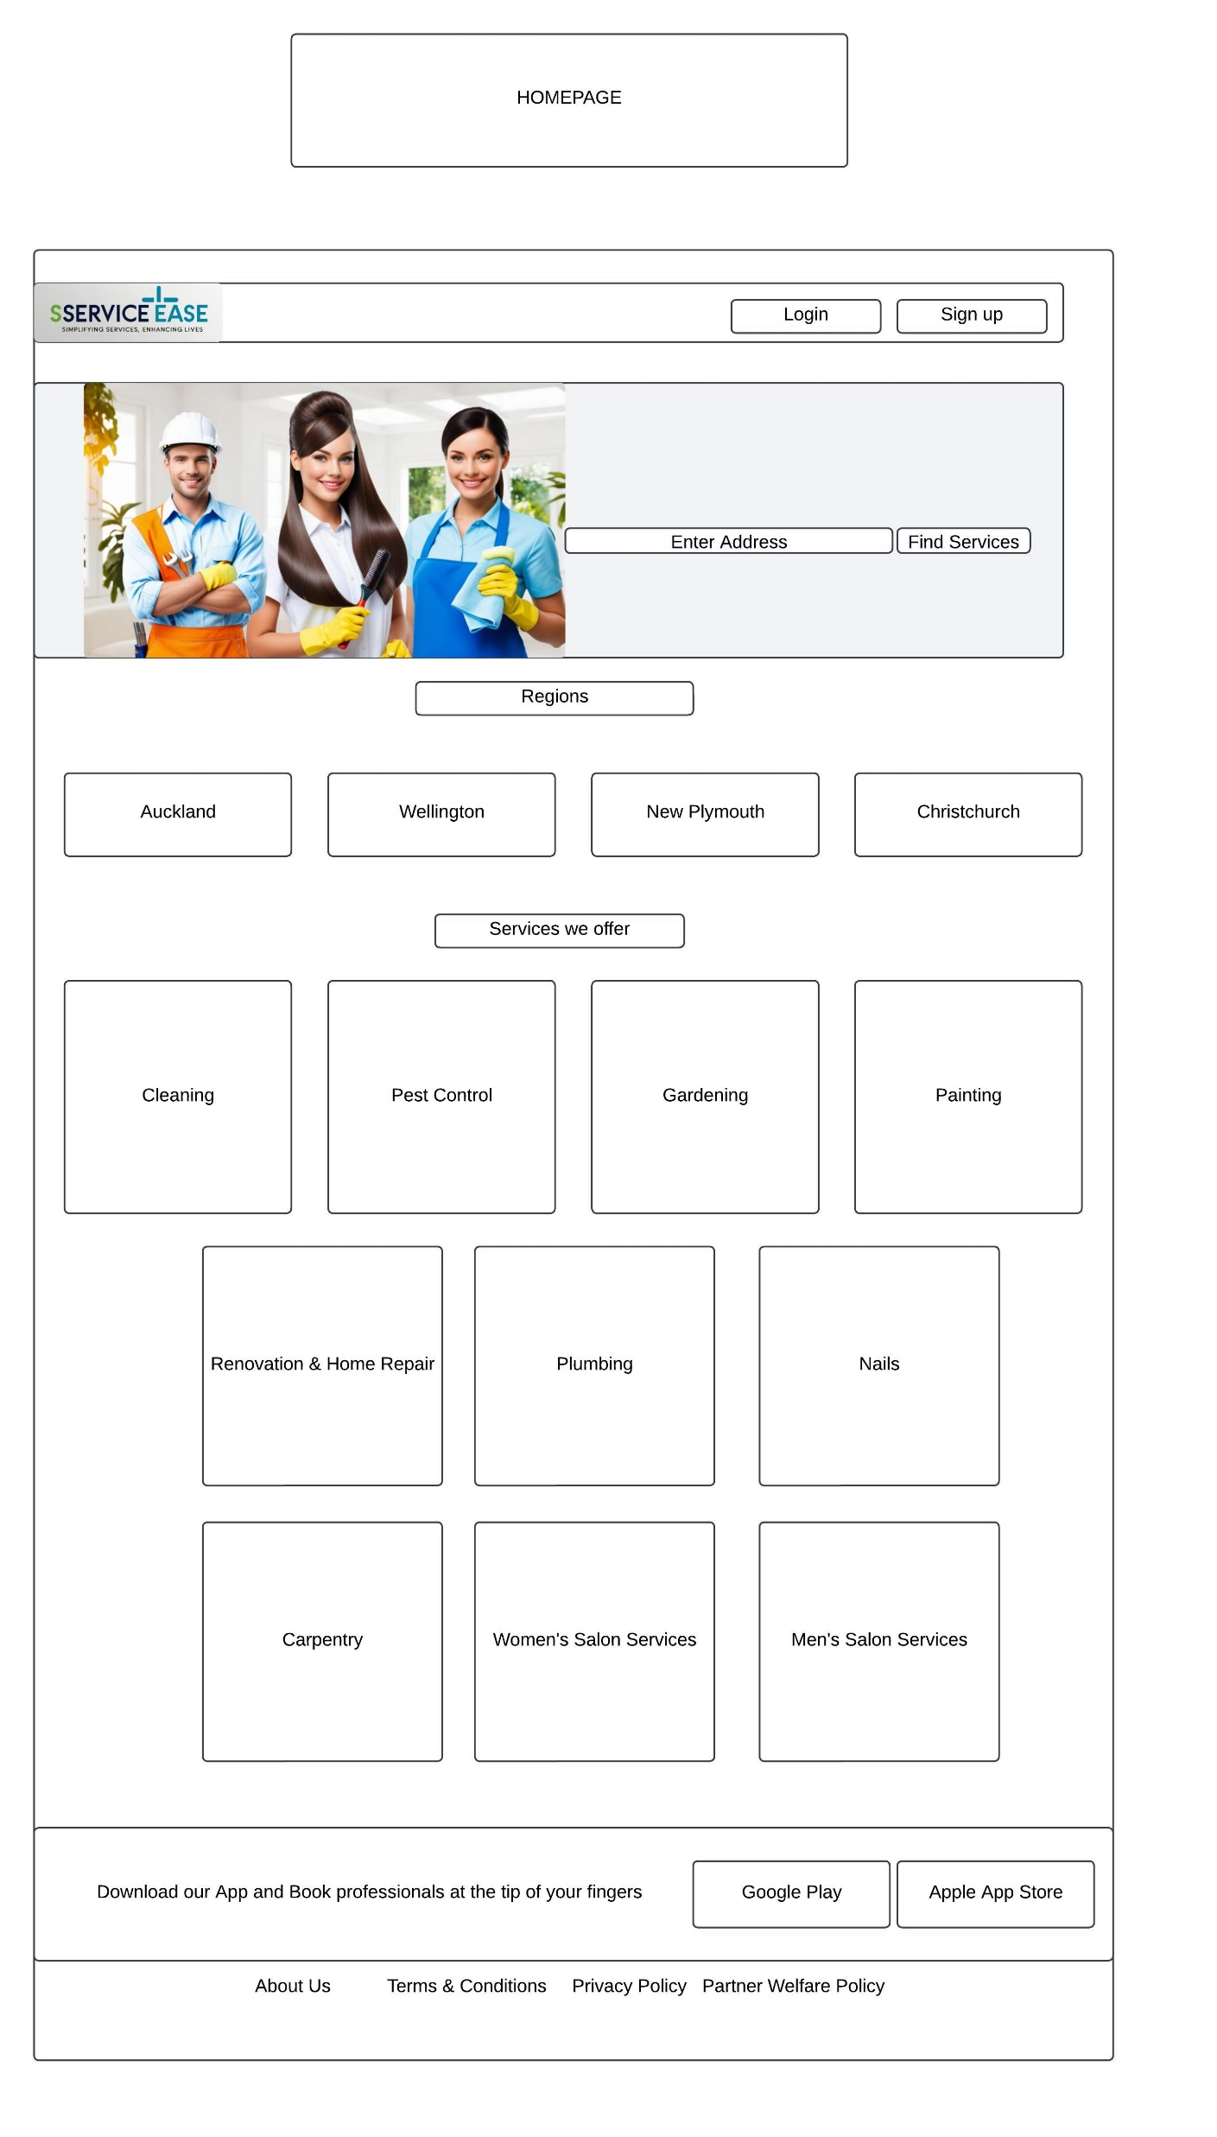
UI Design & Wireframes

Slide 13
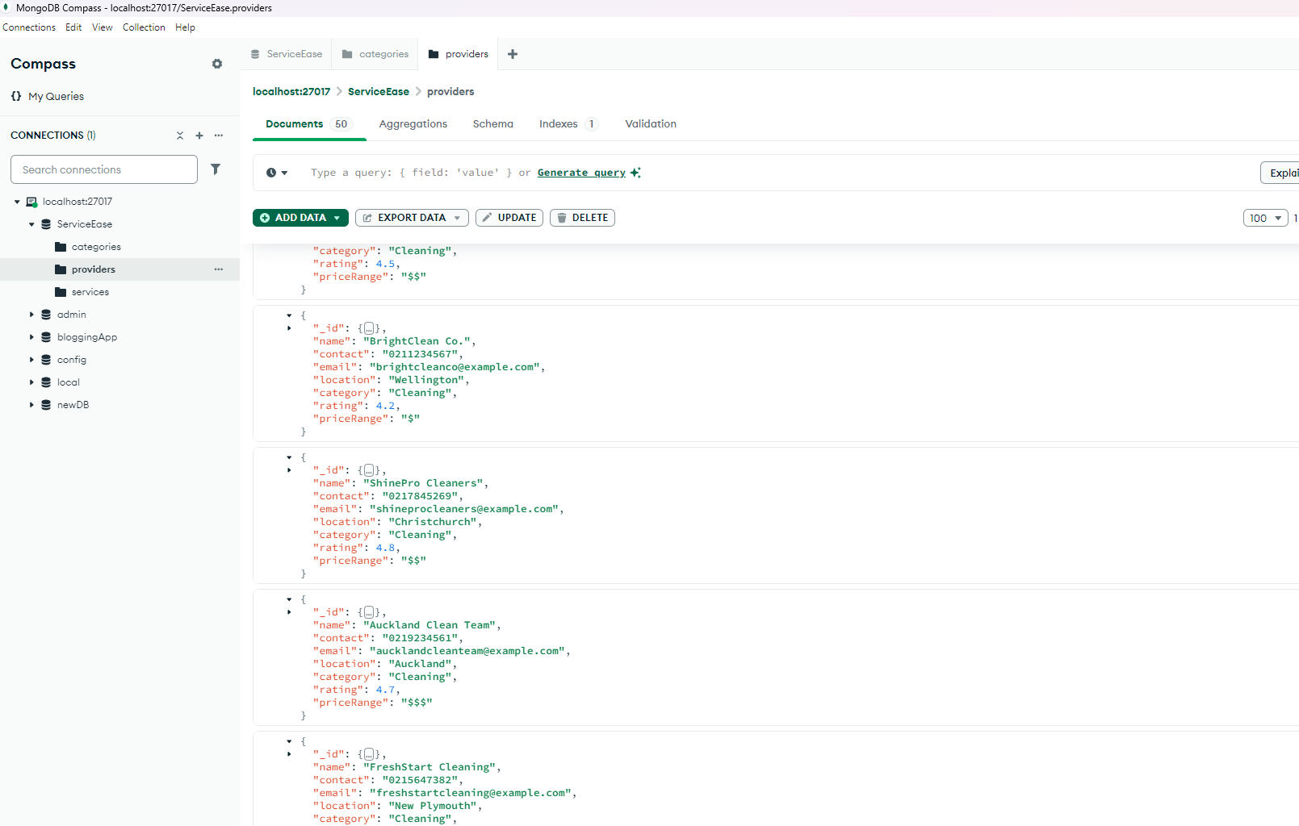
Databases

Slide 14
Benefits of MVC in ServiceEase
Scalability: Each component (Model, View, Controller) is independent, making it easier to add features without affecting other parts of the code.
Readability: Clear separation of concerns makes the codebase easier to understand and maintain.
Reusability: Models and Controllers can be reused across different parts of the application.
Testability: Easier to test individual layers (e.g., unit test Controllers or Views).

Slide 15
Quality & Assurance
Defined a comprehensive testing plan to cover Unit Testing, Integration Testing, End-to-End-Testing, Performance Testing
Configured a local development environment with Test Database on Mongo DB, using Frameworks like Postman, Jest, ensured compatibility across devices and browsers
Verified individual components and APIs : Tested CRUD operations for models like User, Service, and Booking, tested form validations, button interactions, and rendering of dynamic data.
Performance Testing: Ensured data fetched from the backend (e.g., available services) is displayed correctly on the frontend using axios.

Slide 16
Quality & Assurance
Simulated user journeys, such as : User login → Search for a service → Book a service → Receive confirmation
Bug tracking and Fixing: Logged all detected bugs in a tracking tool (e.g., Confluence)
User Acceptance Testing (UAT) : Conducted testing sessions with early users (both customers and providers).Gathered feedback on usability, functionality, and performance. Made adjustments based on UAT feedback to enhance the app.

Slide 17
Future Features
Service Ratings and Reviews
Subscription Plans
Advanced Search Filters
Mobile Application
AI-Based Recommendations

